Slide 1
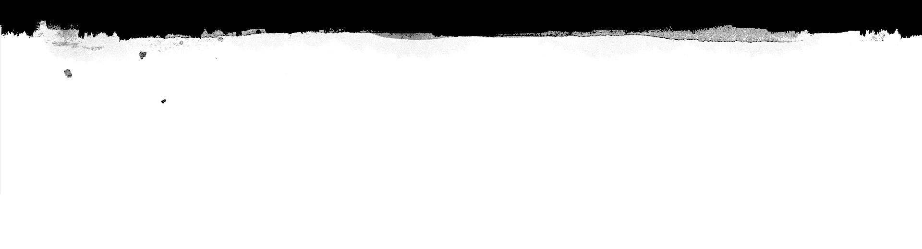

Computational Intelligence (TC2023)

Slide 2

Revise Artificial Neural Network!

Slide 3
General Structure of an ANN
Neural networks take input data, train themselves to recognize patterns found in the data, and then predict the output for a new set of similar data.

Slide 4
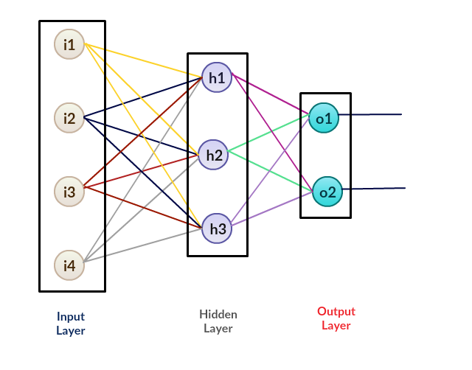
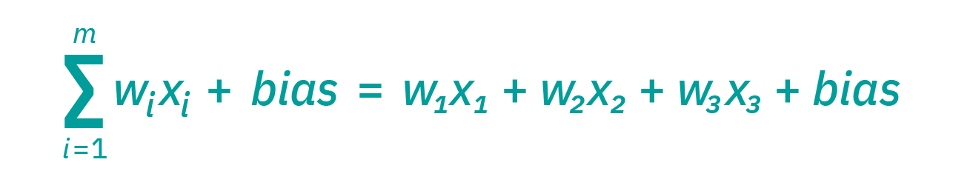
How do neural networks work?
Each node has its own regression model (input data, weights, a bias, and output).
The ANN learns the values to weights that fit better.

Slide 5
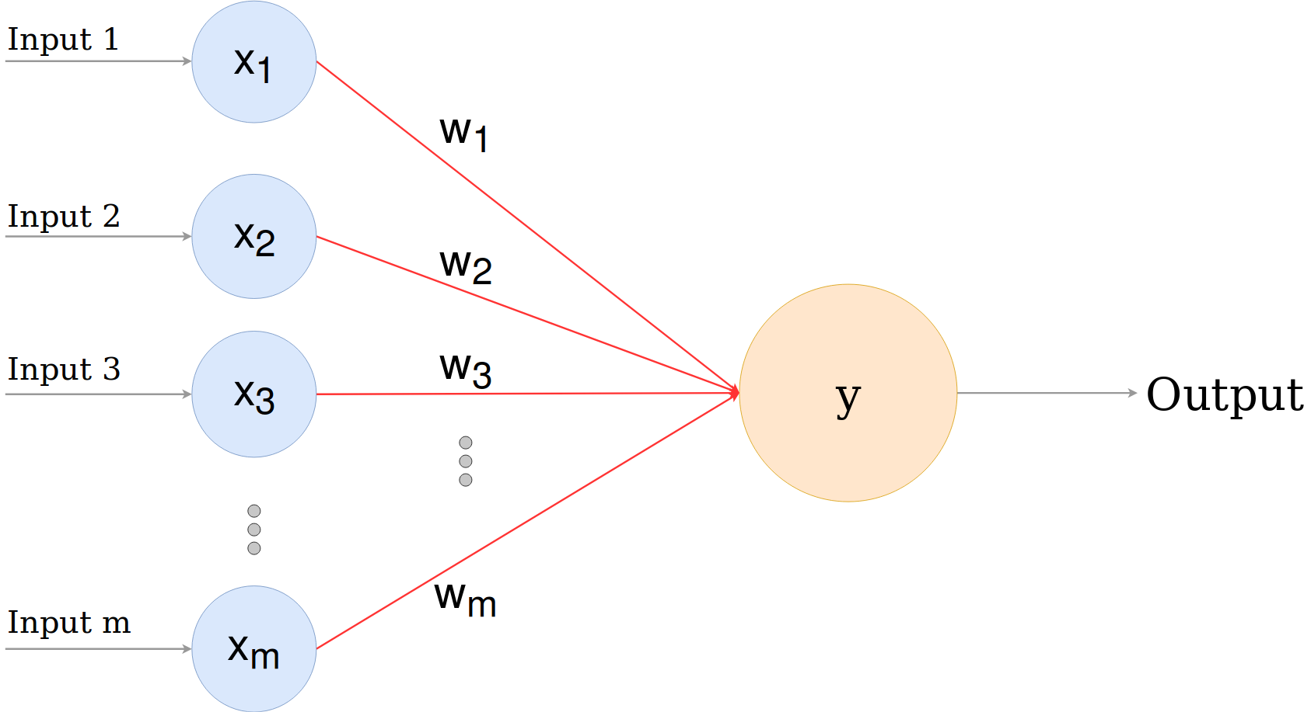
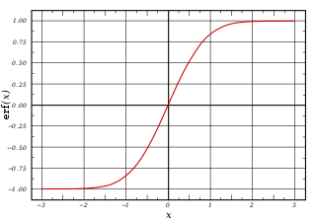
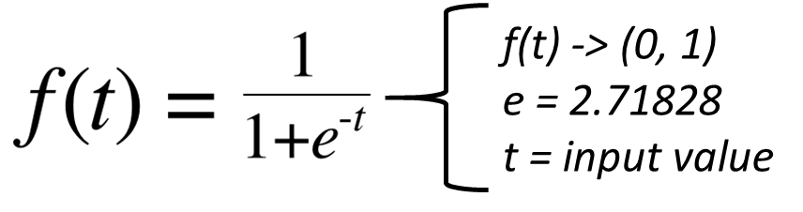
Activation Function
A function that, given an input or set of inputs, transforms them into a specific node's output.
Example: Sigmoid Function

Slide 6
How ANN Works?
Feedforward: On a feedforward neural network, we have a set of input features and some random weights.

Slide 7
How ANN Works?
Backpropagation: phase where we calculate the error between predicted output and target output and then use an algorithm (gradient descent) to update the weight values.

Slide 8
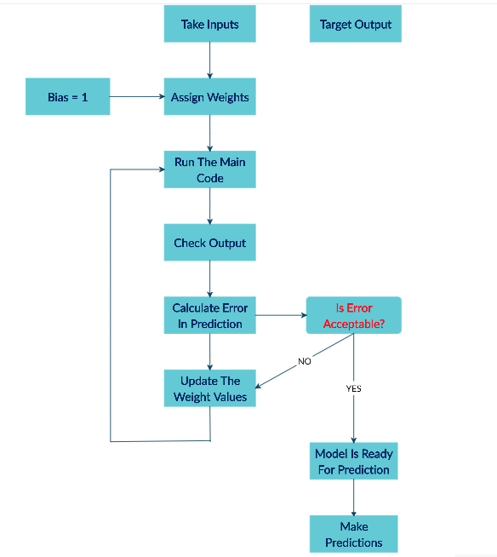
How ANN Works?

Slide 9
ANN Design Steps
Process the data and split into a training and test set
Build the Artificial Neural Network Structure
Train the Artificial Neural Network
Use the model to predict!
Tune the model for better accuracy

Slide 10
Using ANN to Anomalous Detection

Slide 11
Questions to use ANN in Time-Series Forecast
The backpropagation's idea is based on updating the weight values by calculating the error between predicted output and target output and then using an algorithm (gradient descent).
This algorithm does not consider gradient descent results in the past moment, applying the calculation during the defined steps and presenting its results.

Slide 12
Questions to use ANN in Time-Series Forecast
The present prediction involves understanding the past; if you do not know the history, your error increases—an example of this type of problem you can see in the weather forecast.

Slide 13
Recurrent Neural Network (RNN)
RNN is an artificial neural network which learns order dependence in sequence prediction problems .
Unlike standard feedforward neural networks, RNN has feedback connections.

Slide 14
Recurrent Neural Network (RNN)

Slide 15
RNN Issue
The range of contextual information that standard RNNs can access is in practice quite limited, fail to learn in the presence of time lags more significant than 5 – 10 discrete time steps between relevant input events and target signals.

Slide 16
Long Short-Term Memory (LSTM)
LSTM networks are a type of recurrent neural network (RNN).
LSTM can learn to bridge minimal time lags over 1000 discrete time steps by enforcing constant error flow-through "constant error carrousels" (CECs) within special units, called cells.

Slide 17
Long Short-Term Memory (LSTM)
An LSTM layer consists of a set of recurrently connected blocks, known as memory blocks.
Each one contains one or more recurrently connected memory cells and three multiplicative units – the input, output, and forgets gates – that provide continuous analogs of write, read and reset operations.

Slide 18
Long Short-Term Memory (LSTM)

Slide 19
Computational Intelligence (TC2023)

